Slide 1
AIML CA1:
Regression
Emmett Chua • P2222457

Slide 2
Problem statement
Develop a regression model to predict the price of houses in US
Target variable
Price ($) - The value of different houses in US
Dataset
545 rows of data on customers
6 different features [City, House area (sqm), Number of bedrooms, Number of toilets, Stories and Renovation status]

Slide 3
EDA : Uni-Variate analysis
Similar amount of houses from different regions
New york - 28.99%
Seattle - 24.59%
Boston - 19.27%
Denver - 16.33%
Chicago - 10.83%
No Null values
None of the 545 rows of data have any null values or empty values
Variations in numerical columns
The largest house has an area of 1620sqm while the smallest has 165sqm. This could possibly affect the model in prediction

Slide 4
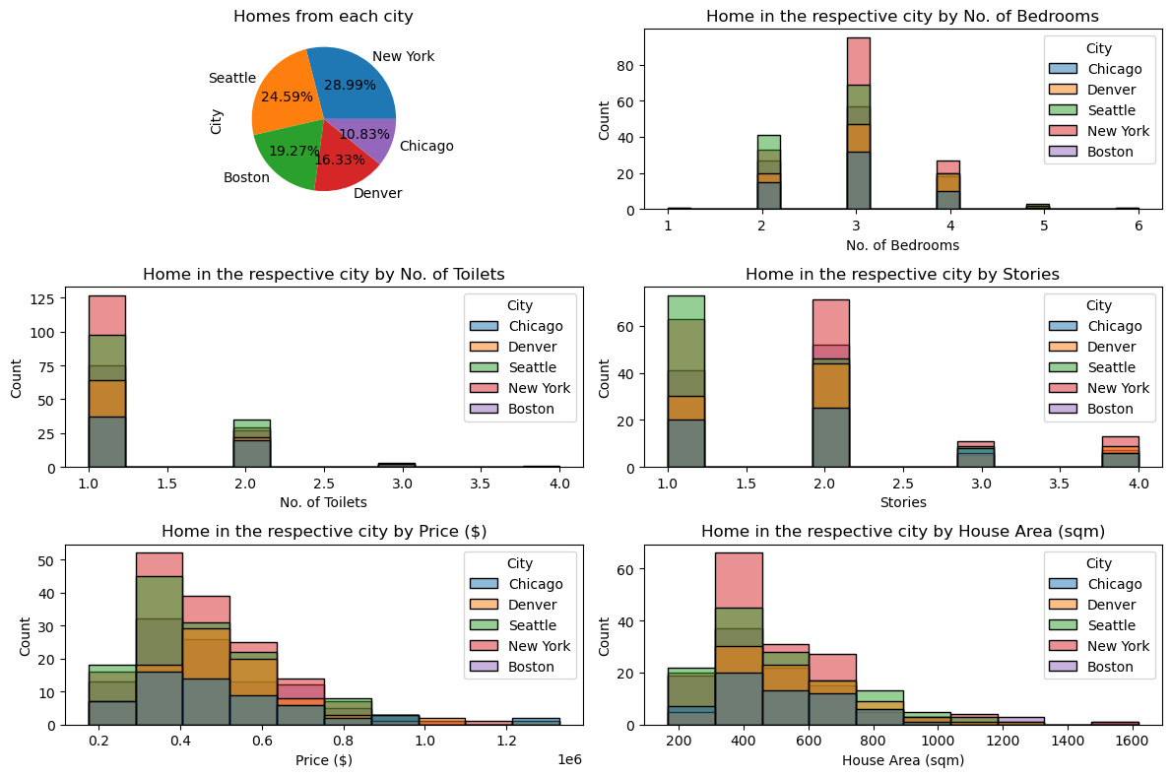
EDA : Uni-Variate analysis
number of bedrooms seem to be more normally distributed, with 3 being the median.
number of toilets as well as number of stories have shown little pattern in its distribution.
price and house area seem to be skewed to the right and show very similar graphs. This could mean that there is a possible correlation between the 2 features.

Slide 5
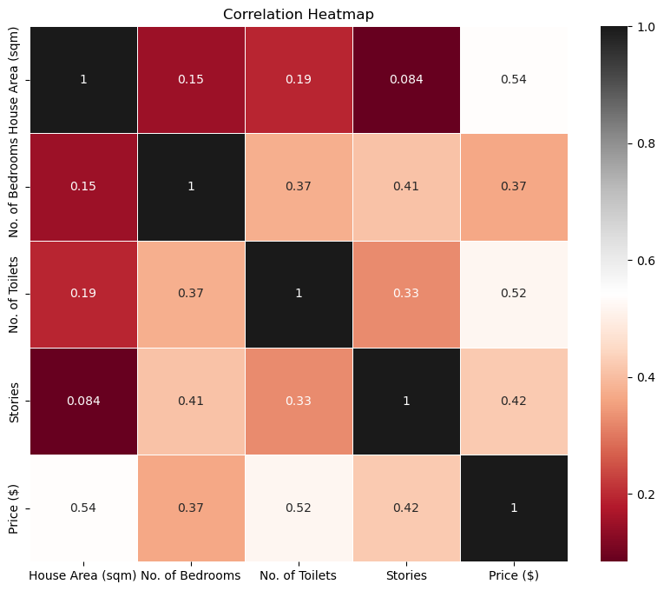
EDA : Bi-Variate analysis
There is a moderate correlation between house area and price as well as number of toilets and price. This shows that these two features could be more significant than the rest of the features.

Slide 6
Data Preprocessing
1. Encoding
To change categorical features into numerical values so that it can be used for the model, one-hot-encoding was applied
2. Feature Engineering
This helps to improve the predictability of the model. ‘Price/sqm’, a ratio of how much it costs per sqm in the respective house is engineered to the data
3. Data Splitting
8:2 split to leave out some data that can be used to evaluate the model. Cross validation will be used on the training set as well.

Slide 7

Model selection
Models selected
Knowing that this model has no particular characteristic, a few different models were tested
Evaluation strategy
Root Mean Square Error (RMSE)- the average difference between the predicted value and the actual value
Comparison to dummy model
The dummy regressor which randomly guesses the value of the house based on the average price has a RMSE score of almost 200k, which is very far from the actual values, given that the prices are around 1m
Selected model
Random Forest Regressor had the lowest RMSE of around 31k

Slide 8
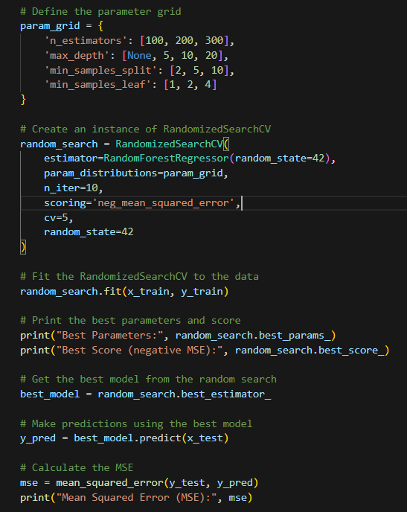
Model tuning
Applying trial and error, a range of values have been selected to find the most optimised parameters for the selected model.

Slide 9
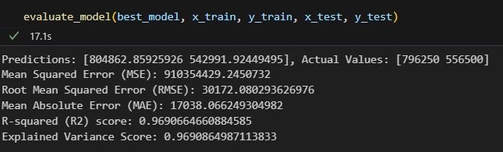
Model evaluation
The predicted values are very close to the actual values of the house
RMSE is around 30k
The model can explain about 97% of the variations in the dataset, showing that it is performing well despite RMSE being such a large value like 30k

Slide 10
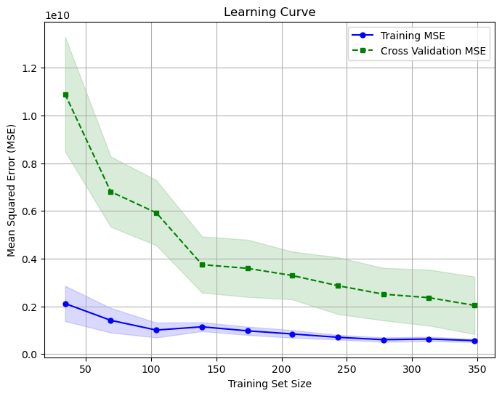
Model evaluation
The MSE of the model improves as the training set size gets bigger and it shows that is has less room for improvement already

Slide 11
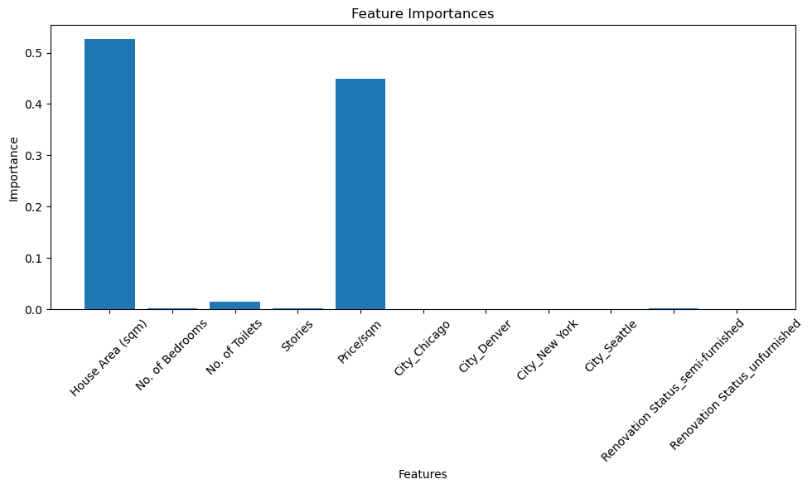
Feature importance
The model shows that the features House Area (sqm) and the engineered column Price/sqm have the highest importance in the model prediction
The remainder of the features show little importance in the prediction model

Slide 12
Conclusion
Random forest regressor is a good model for the prediction of the price of houses in US given the different features each house has. However, there is still a small number of houses that it predicts to be quite different from the actual price

